Slide 1



PROJECT
UPDATE
Reinforced Racer - An AI Based Racing Simulator
PRESENTED BY:
GROUP - 10
Syed Sakibul Haque - 1620298042
Md. Saidur Rahman Antu - 1911512042
Naima Siddika Toha - 2013506642
Saima Arafin Smrity - 1913061042

Slide 2
Overview
Reinforced Racer is a simulation-based racing game where players train autonomous cars using Reinforcement Learning (RL). Instead of controlling the car manually, players build and train AI agents to navigate complex racetracks, avoid crashes, and complete laps as efficiently as possible. The initial version of the game leverages Deep Q-Learning (DQN) with a custom Gymnasium-compatible environment, featuring ray-based sensors, dynamic reward systems, and checkpoint tracking. This project merges game development with machine learning to demonstrate how AI can learn real-time decision-making in simulated driving environments.
GROUP - 10
Syed Sakibul Haque
Md. Saidur Rahman Antu
Naima Siddika Toha
Saima Arafin Smrity

Slide 3


Objectives and Goals
Goal # 1
Goal # 2
Goal # 3
Create a RL model by training the models on complex 2D tracks.
Create a 3D environment for the game using Unity Engine.
Implement RL model on the 3D environment and optimize further.
GROUP - 10
Syed Sakibul Haque
Md. Saidur Rahman Antu
Naima Siddika Toha
Saima Arafin Smrity

Slide 4

GitHub Repository
Reinforced Racer
GROUP - 10
Syed Sakibul Haque
Md. Saidur Rahman Antu
Naima Siddika Toha
Saima Arafin Smrity

Slide 5
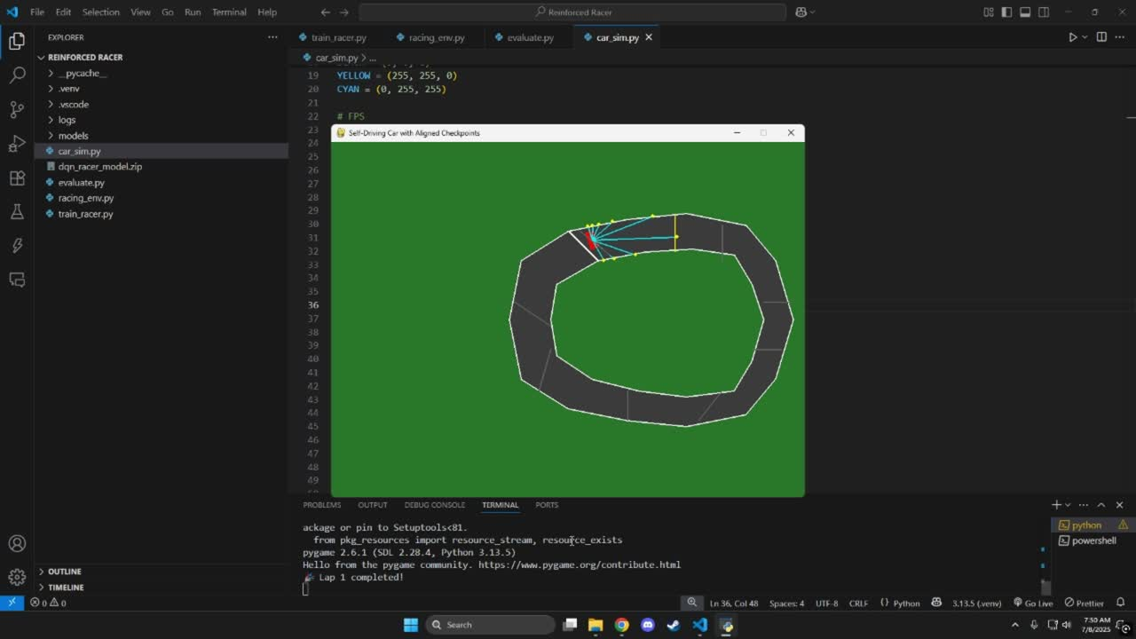
Simulated LiDAR Based Car Movement
GROUP - 10
Syed Sakibul Haque
Md. Saidur Rahman Antu
Naima Siddika Toha
Saima Arafin Smrity

Slide 6
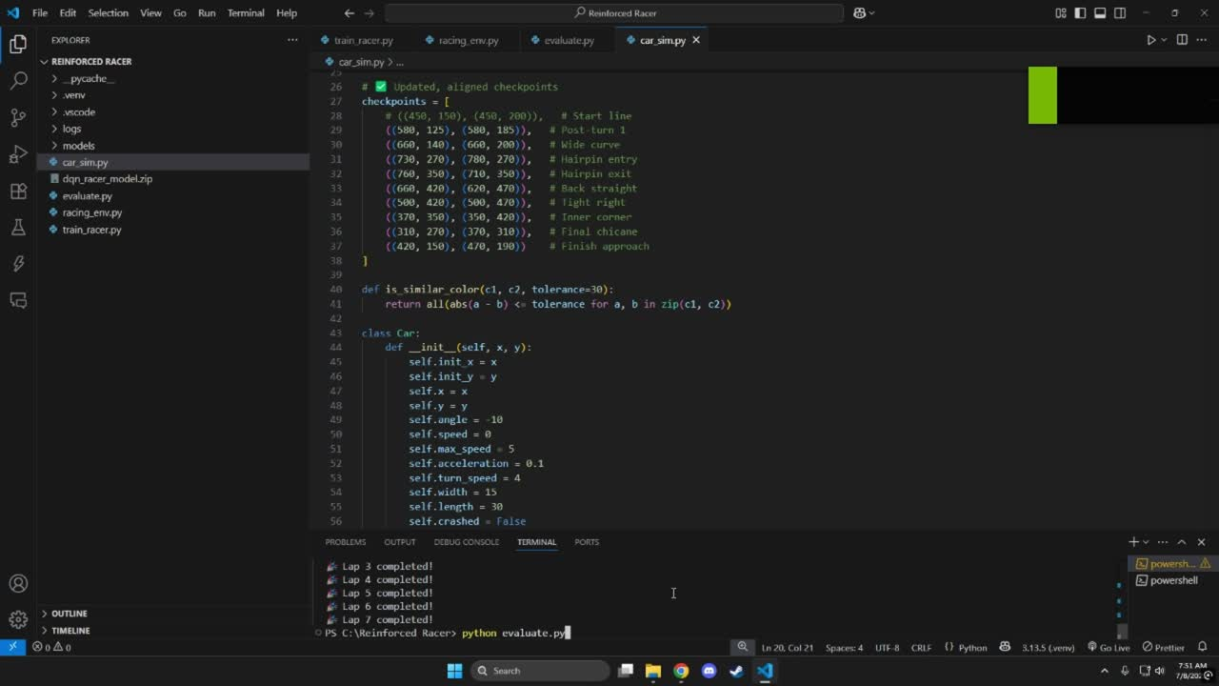
Trained Car Movement
GROUP - 10
Syed Sakibul Haque
Md. Saidur Rahman Antu
Naima Siddika Toha
Saima Arafin Smrity

Slide 7
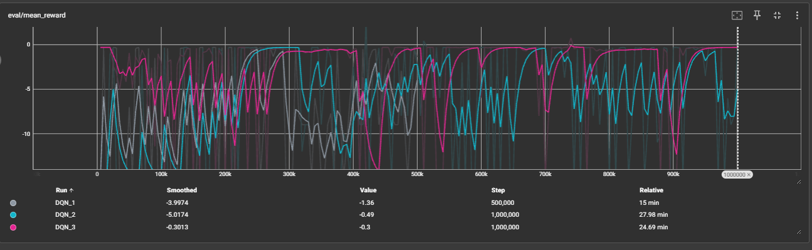
Model Evaluation
GROUP - 10
Syed Sakibul Haque
Md. Saidur Rahman Antu
Naima Siddika Toha
Saima Arafin Smrity

Slide 8
Thank you
GROUP - 10
Syed Sakibul Haque
Md. Saidur Rahman Antu
Naima Siddika Toha
Saima Arafin Smrity

